Slide 1
Low Voltage Electronics
Matthew Whitworth

Slide 2
What does Low Voltage mean?
In industry refers to voltages between 120 and 1500 V DC
Above and below that is High Voltage and Extra Low voltage respectively
LV in NU Racing informally used to refer to all electronics within the car that are not (informally) “High Voltage” or accumulator pack voltage (approx. 400 V DC)

Slide 3
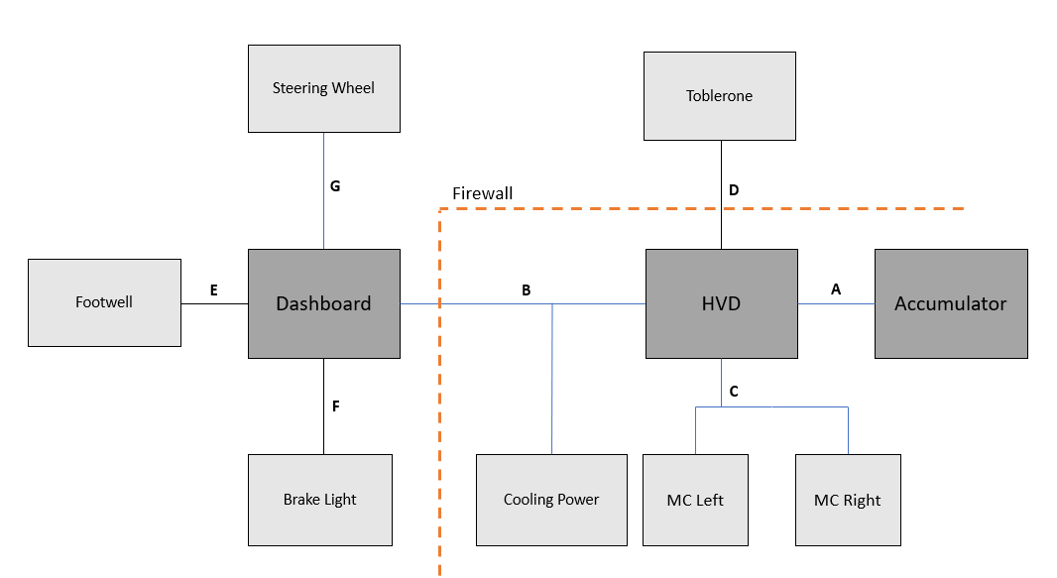
EV3’s Nervous System

Slide 4
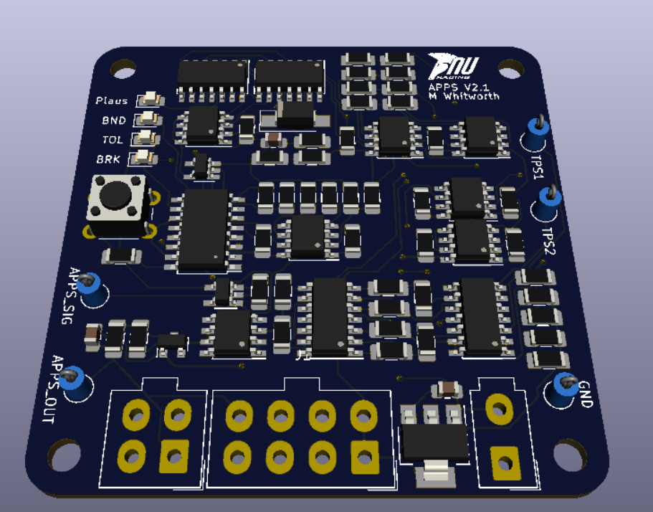
Dashboard - APPS
Accelerator Pedal Position Sensor
Converts two accelerator pedal signals into a single 0 to 5 V signal
Checks for plausibility of input signals; whether or not they agree.
Anti-trail braking control

Slide 5
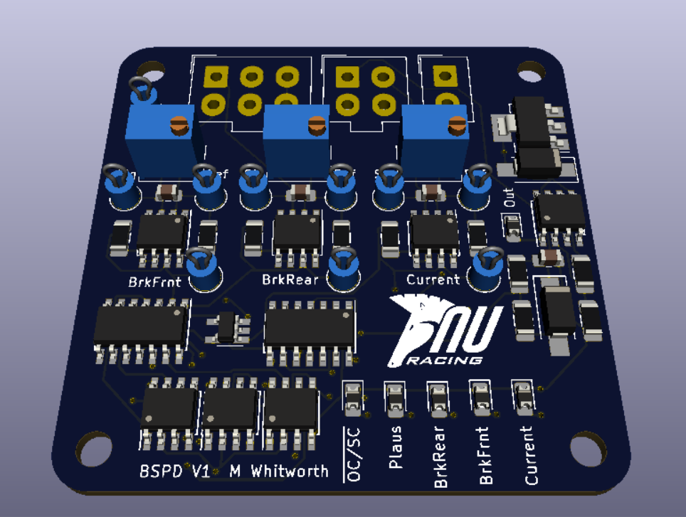
Dashboard - BSPD
Brake System Plausibility Device
Based on brake pressure and accumulator power draw
Outputs a hard fault if 5 kW of power is drawn whilst braking hard for over half a second or if sensor implausibility detected
Part of the shutdown circuit

Slide 6
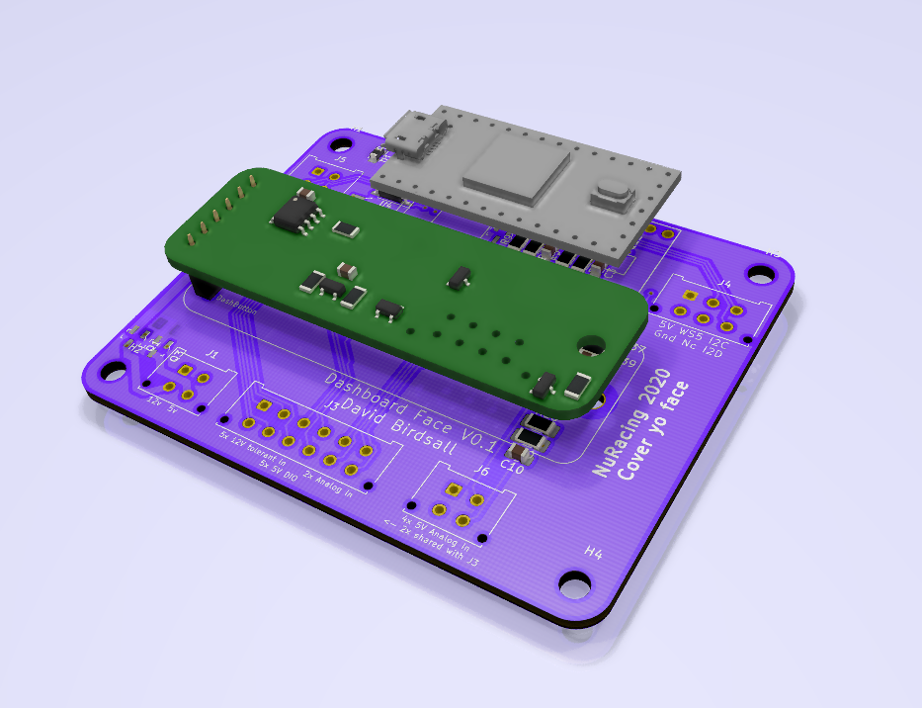
Dashboard/HVD – Teensy I/O Card
Teensy Expansion Card
Provides interface to the CAN bus in dashboard and high voltage disconnect enclosures
Controls Ready To Drive functionality of car
Provides general purpose I/O where needed
Customisable to suit needs

Slide 7
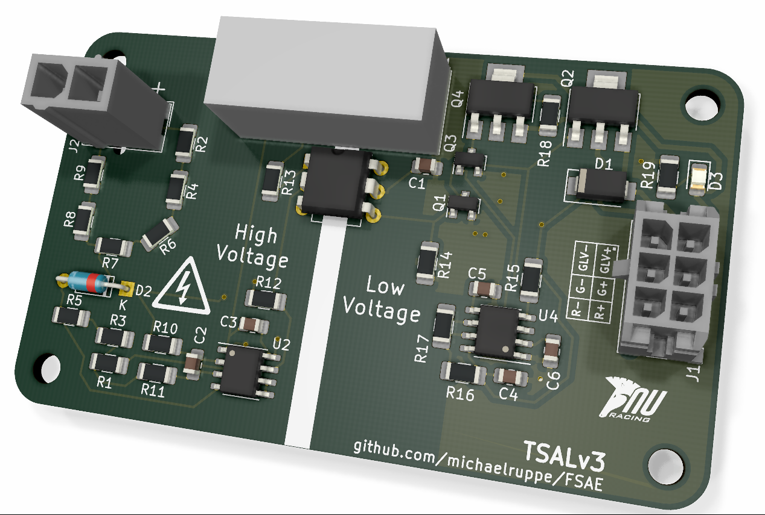
HVD – TSAL
Tractive System Active Light
Measures the voltage on the tractive system
Controls the indicator lights on the Toblerone
Blinks red if TS above 60 V
Otherwise displays solid green light

Slide 8
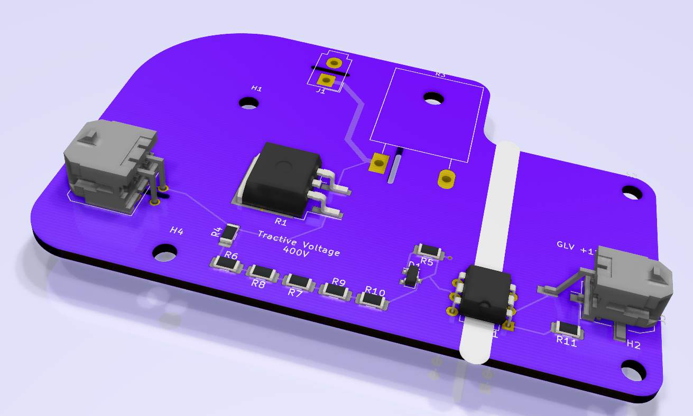
HVD – Discharge
Discharge circuit
Monitors the status of shutdown circuit
If shutdown circuit is opened, begins discharging TS through power resistor

Slide 9
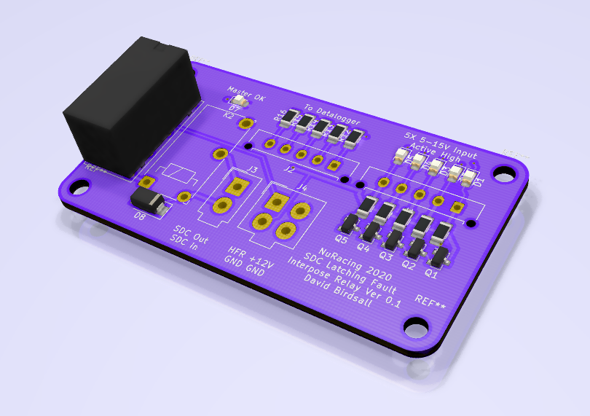
HVD – HFL
Hard Fault Latch
Monitors 4 digital hard fault inputs
BSPD, Pre-charge, IMD and BMS
Breaks the shutdown circuit should any fault be detected and latches in a fault state until reset
What is a hard fault?
Must be reset externally (not by driver) with button on HVD

Slide 10
Accumulator LV Systems
Pre-charge Circuit
Waits for OK signal from shutdown circuit
Charges the TS through a power resistor
Closes positive AIR once charged
Outputs a hard fault if power resistor overheats
IMD
Monitors resistance between HV and LV side of car
Outputs a hard fault if resistance too low
BMS
Monitors accumulator cells
Outputs a hard fault under certain conditions (over-temp, under voltage, comms error)

Slide 11
Shutdown Circuit
Provides power to the Accumulator Isolation Relays (AIRs)
Loops throughout the car
HFL interfaces digital hard faults into shutdown circuit via a common relay
Directly powers negative AIR, powers positive AIR once TS charged
Components:
3 x E-Stops
Tractive System Master Switch (TSMS)
Inertia Switch
Brake Over Travel Switch
High Voltage Disconnect interlock
High Voltage Interconnect interlock
Hard Fault Latch (HFL):
BSPD
Pre-charge
IMD
BMS
Other HV connector interlocks

Slide 12
Electrical System Form - ESF
Documents entire electrical system, both control and Tractive System
Must visualise interconnection/topology and voltage level of entire vehicle
Must show construction and build of the accumulator
Must provide data sheets for all TS components used and show that component ratings are not exceeded (voltage and stress ratings for e.g.)

